Slide 1
Predicting future outcomes for Turtle Games
Francesca Galli

Slide 2
Agenda
Background and context
Analytical approach
Visualisation, insights and predictions
Recommendations and next steps

Slide 3
Background and context
Turtle Games is a game manufacturer and retailer who are aiming to improve overall sales performance by utilising customer trends
In particular, they want to:
understand how customers accumulate loyalty points
develop customer segmentation
understand social data to inform marketing campaigns
understand the impact of each product on sales
test the reliability of sales data
understand any potential relationship between sales in different regions

Slide 4
Analytical approach
Two datasets were taken into consideration: a Reviews dataset (turtle_reviews.csv) and a Sales dataset (turtle_sales.csv)
Reviews dataset - analysed with Python:
Checked missing values, summary stats, selected columns of interest
Regression analysis on socio economic data
Customer segmentation with k-means clustering
Natural language processing on customer reviews
Sales dataset– analysed with R:
Checked missing values, summary stats, selected columns of interest
Exploratory analysis and checking normality of data
Simple and multiple linear regression on sales data across different regions

Slide 5
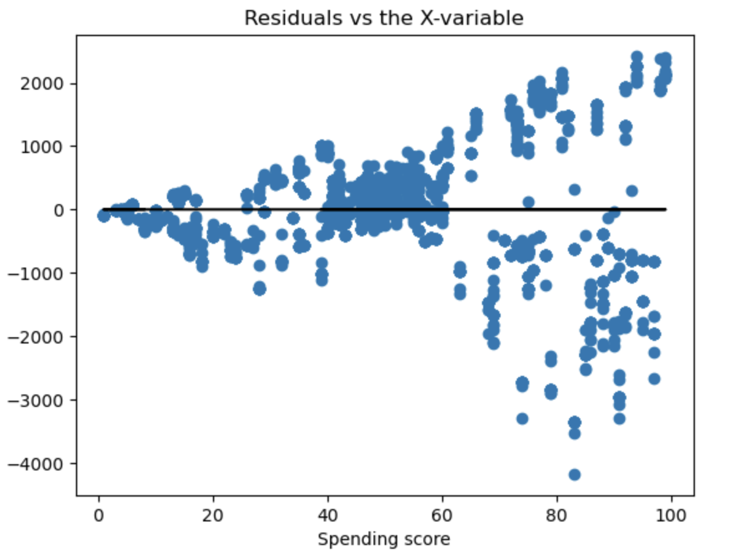
Visualisation, insights and predictions (I) – Reviews dataset
When analysing customer loyalty and spending, we found a positive correlation
However, none of the three linear regression models (loyalty vs spending, remuneration, age) are satisfactory - they all present heteroscedasticity which makes the any interpretation of the regression coefficients unreliable.
See example of heteroscedasticity for the loyalty-spending model:

Slide 6
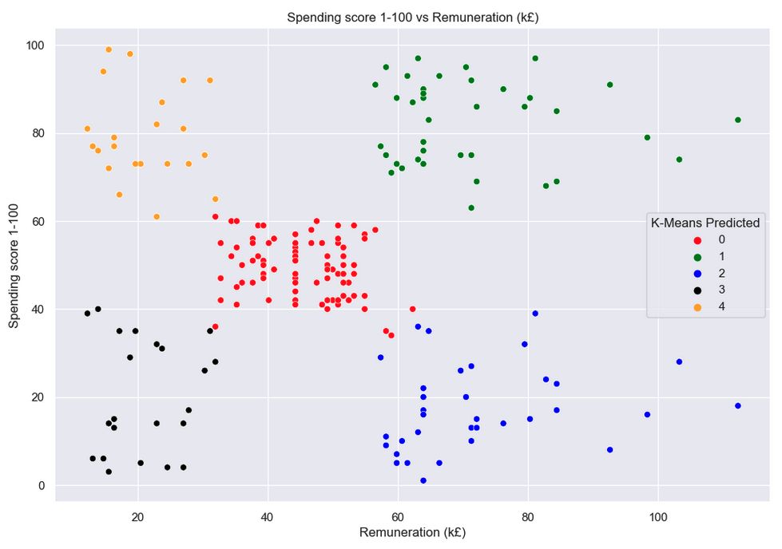
Visualisation, insights and predictions (II) – Reviews dataset
Five customer clusters were identified according to spending score and remuneration:
(0) Medium spend, medium remuneration;
(1) High spend, high remuneration;
(2) Low spend, high remuneration.
(3) Low spend, low remuneration;
(4) High spend, low remuneration;
Five clusters were selected as the business reasoning and the graphical output create a coherent interpretation.

Slide 7
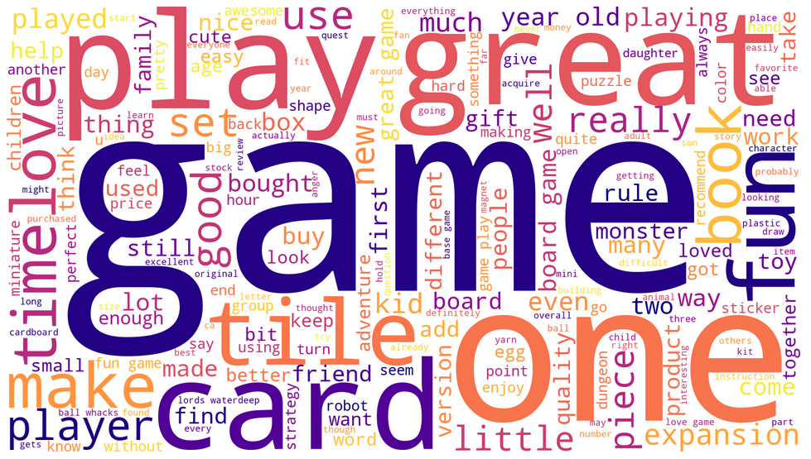
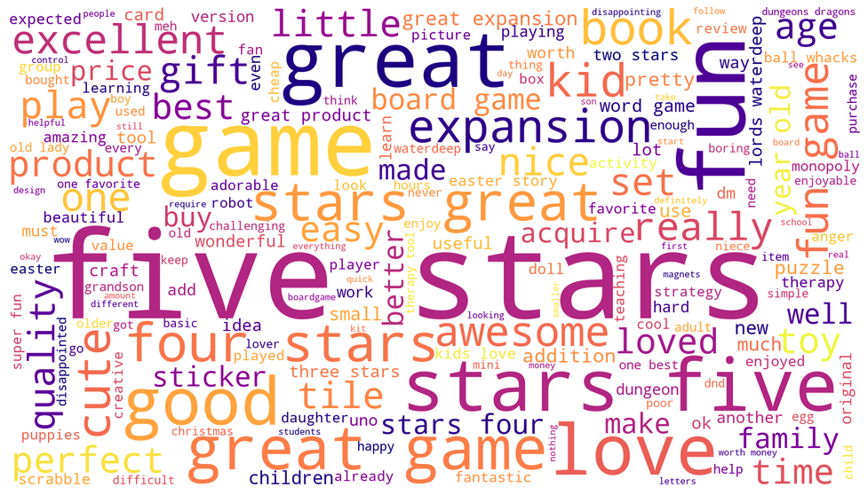
Visualisation, insights and predictions (III) – Reviews dataset
We can see that "game" ranks high in frequency in both reviews and summaries and it is classified as having a negative sentiment score.
Stakeholders should be aware of this limitation - given that the company's business is primarily in games, the frequency of the word "game" is not surprising and for this reason it should probably be excluded from the sentiment analysis.
Other interesting words for business consideration are: cards, kids, expansion
Reviews word cloud
Summaries word cloud

Slide 8
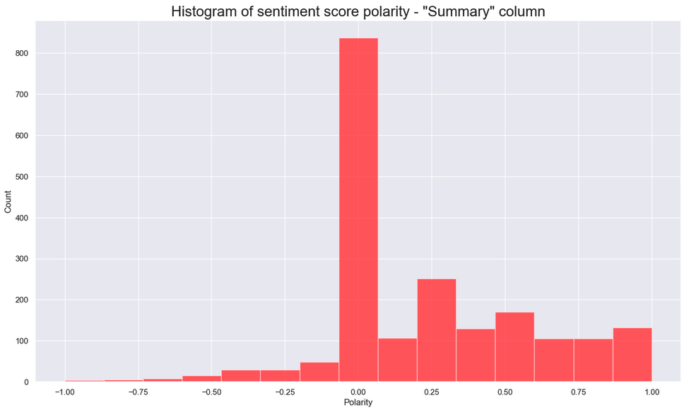
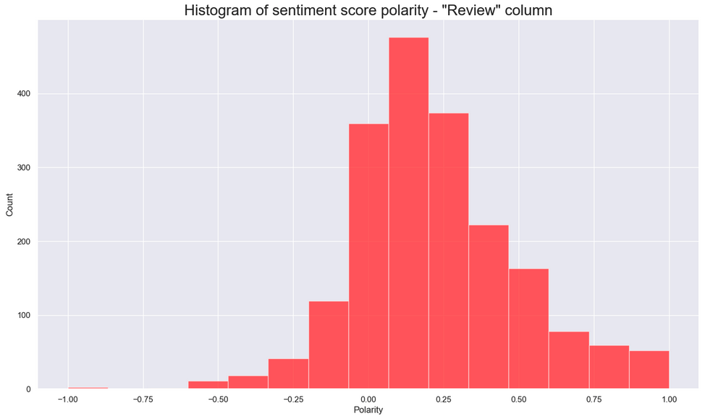
Visualisation, insights and predictions (IV) – Reviews dataset
Both reviews and summaries register sentiment that is positively skewed, as shown in the histograms for polarity
There appears to be a greater concentration of reviews classed as positive sentiment than there are summaries, which on the other hand have a high concentration of neutral sentiment.

Slide 9
Visualisation, insights and predictions (V) – Sales dataset
There appears to be positive correlations amongst the three sales variables (Global, North America and EU sales)
We excluded 5 outliers (>£17 million) from these chart in order to zoom in on the bulk of the data that sits at lower values

Slide 10
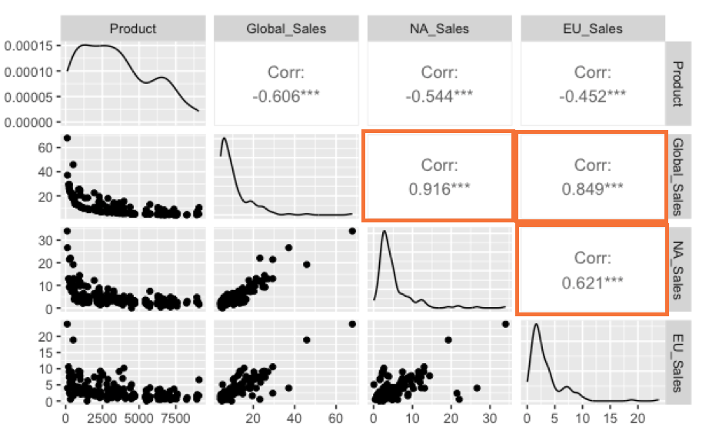
Visualisation, insights and predictions (VI) – Sales dataset
We can see that the majority of products has total global sales below £10 million, and the skewness and kurtosis analysis support this view.
We computed correlations between the sales data of global, NA and EU to prepare for regression analysis:

Slide 11
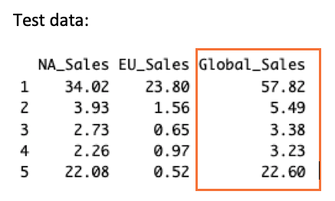
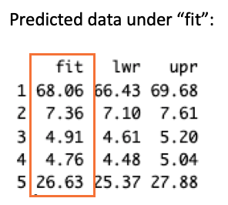
Visualisation, insights and predictions (VII) – Sales dataset
After evaluating correlations in previous step, we proceeded to fit linear models:
two linear regression models comparing global sales against NA sales and EU sales
a multiple linear regression model to check see whether we could better explain the relationship between the sales variables, with global sales as the dependent variable
We found the two simple linear regression models to have problematic residuals distributions rendering estimates unreliable
The multiple linear regression model had a better residual distribution, however the predicted values when compared to a test set were off mark – see table:

Slide 12
Recommendations and next steps
There is positive correlation between customer loyalty and spending and remuneration – we recommend transforming the loyalty variable (e.g. by taking its log) to better interpret the regression coefficients
The customer groupings identified can be used to target customers according to spending – for example, high convenience items to low spend, low remuneration segment
In terms of customer reviews, it would be insightful to understand which products and type of clients are associated with the most negative and the most positive reviews, to determine whether any patterns can be identified
Finally, with regards to sales, we would recommend fitting a linear regression model with other variables such as platform, genre, publisher to check whether they reveal other patterns that might influence sales globally, and whether such a model can make better predictions

